Slide 1
Diyala university
College of engineering
Department of computer engineering
Second stage
8086 Microprocessor
Assistant lecturer: Abdullah Thaier Abdalsatir

Slide 2
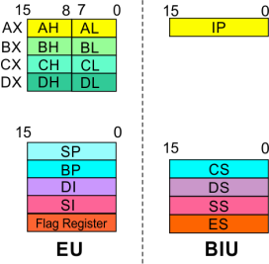
8086
Microprocessor
Architecture
Bus Interface Unit (BIU)
Segment
Registers
Stack Segment
Register
16-bit
Points to the current stack.
The 20-bit physical stack address is calculated from the
Stack Segment (SS) and the Stack Pointer (SP) for stack
instructions such as PUSH and POP.
In based addressing mode, the 20-bit physical stack
address is calculated from the Stack segment (SS) and the
Base Pointer (BP).
21

Slide 3
8086
Microprocessor
Architecture
Bus Interface Unit (BIU)
Segment
Extra Segment Register
Registers
16-bit
Points to the extra segment in which data (in excess of
64K pointed to by the DS) is stored.
String instructions use the ES and DI to determine the 20-
bit physical address for the destination.
22

Slide 4
8086
Microprocessor
Architecture
Bus Interface Unit (BIU)
Segment
Registers
Instruction Pointer
16-bit
Always points to the next instruction to be executed within
the currently executing code segment.
So, this register contains the 16-bit offset address pointing
to the next instruction code within the 64Kb of the code
segment area.
Its content is automatically incremented as the execution
of the next instruction takes place.
23

Slide 5
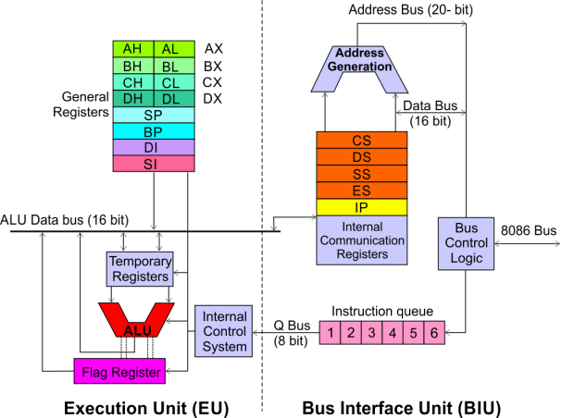
8086
Microprocessor
Architecture
Bus Interface Unit (BIU)
Instruction
A group of First-In-First-
Out (FIFO) in which up to
6
bytes
of
instruction
code are pre-fetched from
the
ahead of
memory
time.
This is done in order to
speed up the execution by
overlapping
instruction
execution.
fetch
with
This mechanism is known
as pipelining.
24

Slide 6
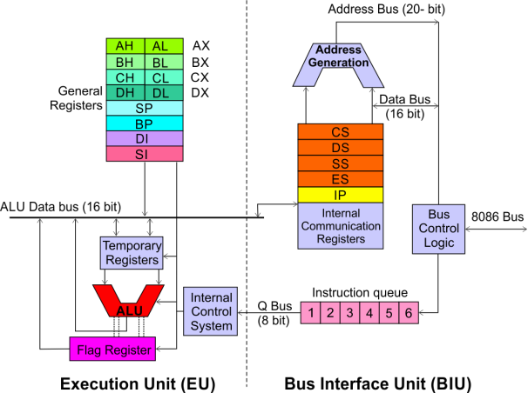
8086
Microprocessor
Architecture
Execution Unit (EU)
EU decodes and
executes instructions.
A decoder in the EU
control system
translates instructions.
16-bit
ALU
for
performing arithmetic
and logic operation
Four general purpose
registers (AX, BX, CX, DX);
Pointer registers (Stack
Pointer, Base Pointer);
Some of the 16-bit registers can be used as two 8
bit registers as:
and
Index registers (Source
Index, Destination Index)
each of 16-bits
AX can be used as AH and AL BX can be used
as BH and BL CX can be used as CH and CL
DX can be used as DH and DL
25

Slide 7
8086
Microprocessor
Architecture
Execution Unit (
EU)
EU
Registers
Accumulator Register (AX)
Consists of two 8-bit registers AL and AH, which can be
combined together and used as a 16-bit register AX.
AL in this case contains the low order byte of the word,
and AH contains the high-order byte.
The I/O instructions
use the AX or AL for inputting /
outputting 16 or 8-bit data to or from an I/O port.
Multiplication and Division instructions also use the AX or
AL.
26

Slide 8
8086
Microprocessor
Architecture
Execution Unit (EU)
EU
Registers
Base Register (BX)
Consists of two 8-bit registers BL and BH, which can be
combined together and used as a 16-bit register BX.
BL in this case contains the low-order byte of the word,
and BH contains the high-order byte.
This is the only general purpose register whose contents
can be used for addressing the 8086 memory.
All memory references utilizing this register content for
addressing use DS as the default segment register.
27

Slide 9
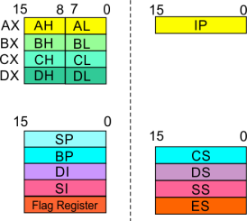
8086
Microprocessor
Architecture
Execution Unit (EU)
EU
Registers
Counter Regist
er (CX)
Consists of two 8-bit registers CL and CH, which can be
combined together and used as a 16-bit register CX.
When combined, CL register contains the low order byte of
the word, and CH contains the high-order byte.
Instructions such as SHIFT, ROTATE and LOOP use the
contents of CX as a counter.
Example:
The instruction LOOP START automatically decrements
CX by 1 without affecting flags and will check if [CX] =
0.
If it is zero, 8086 executes the next instruction;
otherwise the 8086 branches to the label START.
28

Slide 10
8086
Microprocessor
Architecture
Execution Unit (EU)
EU
Registers
29

Slide 11
8086
Microprocessor
Architecture
Execution Unit (EU)
EU
Registers
Stack Pointer (SP) and Base Pointer (BP)
SP and BP are used to access data in the stack segment.
SP is used as an offset from the current SS during execution
of instructions that involve the stack segment in the
external memory.
SP contents are automatically updated (incremented/
decremented)
instruction.
due
to
execution
of
a
POP
or
PUSH
BP contains an offset address in the current SS, which is
used by instructions utilizing the based addressing mode.
30

